Slide 1
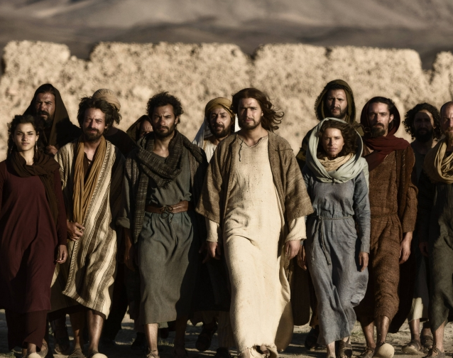
Those who said ‘Yes’ to Christ’s call:
The Saints and Sinners in our Spiritual Ancestry and in Us
Soup & Scripture March 2023
Rev. Elizabeth D. McLean

Slide 2
Opening Sharing
On a scale of 1-10, 1 being not at all and 10 being absolutely all the time:
  How often do you put the needs of others before your own?
  How comfortable are you doing things for others that might cause you harm?
  Have you ever put yourself in danger for the Gospel?
  How flexible are you in your political views?

Slide 3
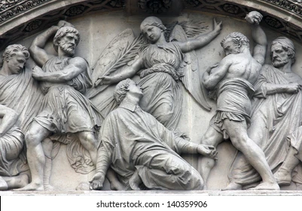
Class Five: Martyrs for a Cause
Judas Iscariot, Stephen, the Apostle Paul

Slide 4

Martyrs for a Cause
The word "martyr" comes originally from the ancient Greek legal term for "witness", for someone who gives testimony or evidence in a court of law.
The term has come to mean someone who gives his or her life for a cause.

Slide 5
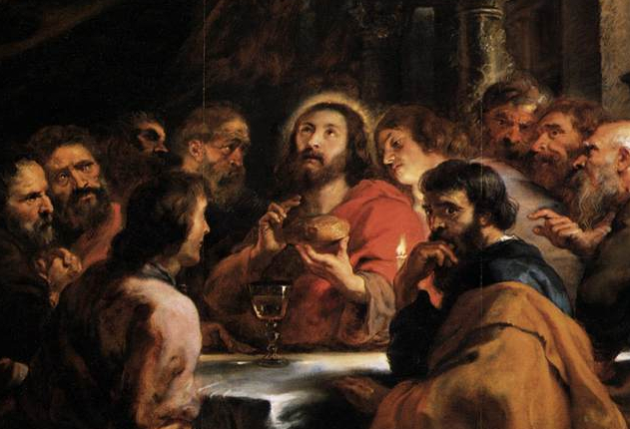
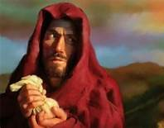
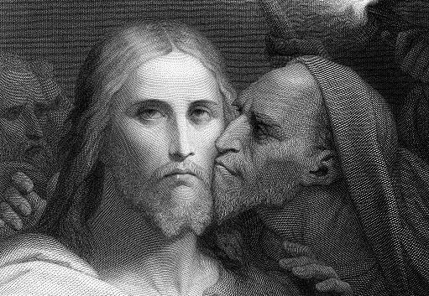
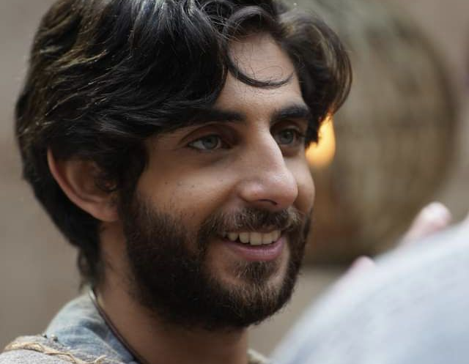
Judas Iscariot

Slide 6
What do we know about him?
Judas Iscariot is listed among the Twelve in all of the gospels.
According to John (12:5-6, 13-29) he acted as treasurer for the group.
He is mentioned 20 times in the gospels and 2 times in Acts.
Initially, around the time of Paul’s letters, Judas was known simply as the one who “handed over” Jesus in the Garden of Gethsemane. But over time he was increasingly demonized. The progression is evident in the gospels.

Slide 7
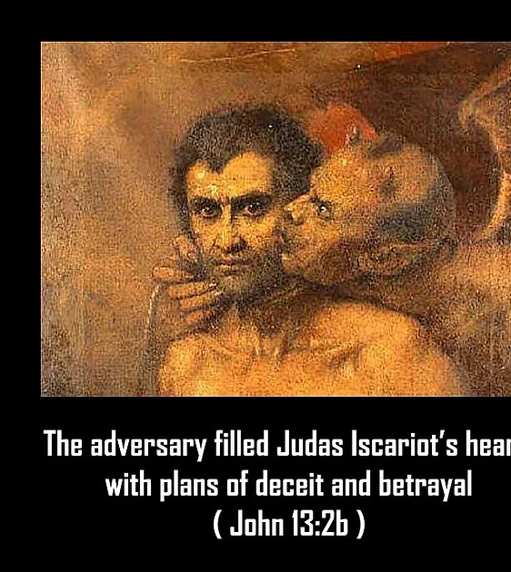
The making of a devil……
Mark 14:3-11 –Judas hands over Jesus seemingly convinced he is going to die soon
Matthew 26:14-16 - Judas betrays Jesus for money then feels remorse
Luke 22:3-53 Judas betrays Jesus because he is possessed by Satan
John 6:71; 12:4; 13:2-20; 18:2-11 Judas is a devil from the beginning. Jesus knows this and implies he chose him counting on this to fulfill God’s plan that Jesus be sacrificed for the people’s sins.

Slide 8
Traditions and Legends
According to Matthew 27:5, Judas tried to bring back the money after Jesus was condemned. The chief priests and elders would not take it, so Judas hanged himself. The authorities used the “blood money” to purchase a potter’s field to be a burial site for foreigners. “For this reason, that field has been called the Field of Blood to this day.”
According to Acts 1:18, Judas himself bought a field with the 30 pieces of silver. Then he fell headlong on the land, burst in the middle, and had his bowels gush out. This is why the field was called the Field of Blood.”

Slide 9
Motivation
Tradition says that Judas was a Zealot because he shares the same name as “Judas the Galilean” whom Acts 5:37 says led a rebellion against Rome in response to the census. Also “Iscariot” is a name associated with the Sicarii, the knife wielding assassins who liked to burn the homes of the wealthy as terrorist attacks.
The non-canonical Gospel of Judas is a pro-Judas document from the First Century which Irenaeus condemned as Gnostic heresy. It paints Judas as the most faithful of the disciples who receives secret revelations of God’s plan through Christ, and through his astute understanding of who Jesus is gets to play the part of sacrificing him. The plot is convoluted and filled with obvious gnostic ideology about the demi-urge and the corrupt nature of earthly things.
After the Church was established, a tradition evolved saying that Judas was the one person on earth who was beyond redemption, even by Christ.
But more recently, some have speculated that Judas thought he was helping Jesus’ cause by precipitating the revolution against Rome. His intentions may have been good.

Slide 10
Martyred or Mistaken?
Given the ambiguity of Judas’ motivation it is hard to say whether he martyred himself for the cause of overthrowing Rome. His death was not in witness to Christ or the Gospel, and did not even acknowledge God’s forgiveness through Christ.
Judas’ witness was to how he believed his way was the only right way. If he betrayed Jesus at his own request, however, then he died a martyr’s death.

Slide 11
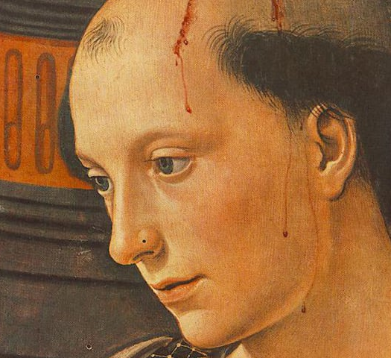
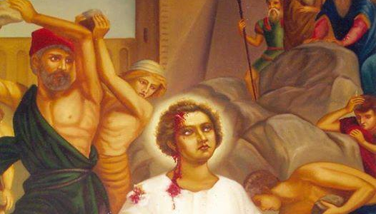
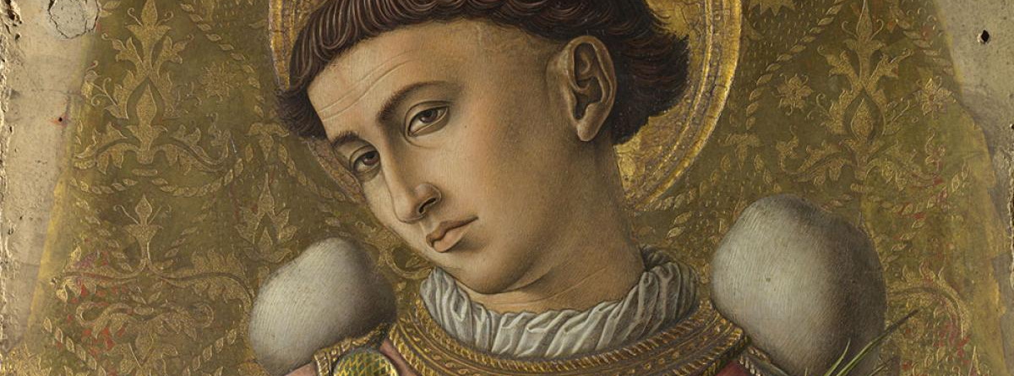
Stephen- The First Martyr for Christ

Slide 12
Acts 6:5, 8- 7:60
Stephen was chosen and ordained with laying on of hands for the task of “waiting on tables” – that is giving widows and orphans a daily distribution of food. His name is Greek, which points to him being one of the many Hellenized Jews from the Diaspora.
The criteria for his selection was that he needed to be “full of the Spirit and wisdom.”
Stephen did “great wonders and signs among the people” because he was full of grace and power.
Some people from a synagogue tried to challenge him but were unsuccessful in argument. So, they offered false testimony to get him arrested. The council which questioned him said he “had the face of an angel.”

Slide 13
Witness even in death
Stephen’s testimony before the council in Chapter 7 of Acts is a synopsis of God’s activity in the world. It enraged his opponents who sought his death.
He was taken outside the city to be stoned to death, remaining faithful to the end because he was given a vision of God and Christ’s glory. He was Christlike in his forgiveness of his murderers. Saul approved of his death and held the coats of his murderers.
Stephen was the first martyr to die for Christ.

Slide 14
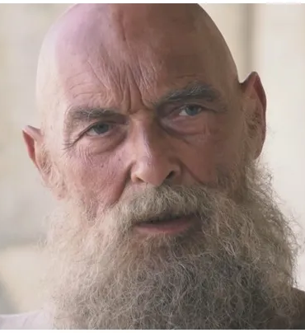
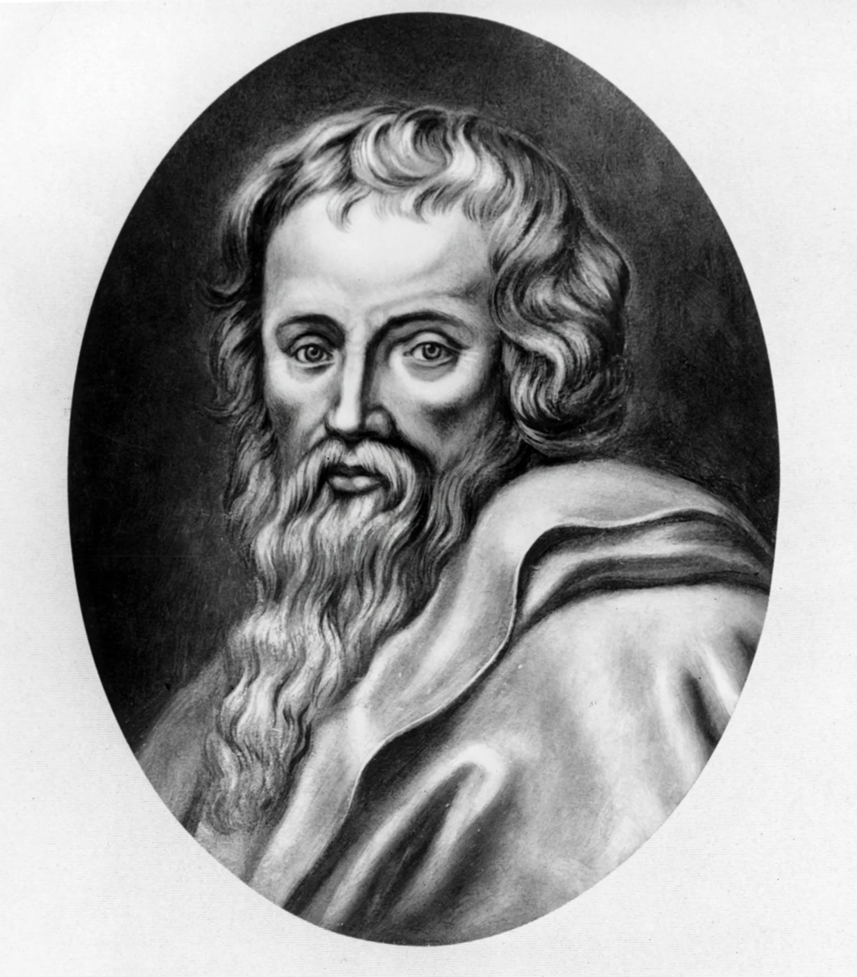
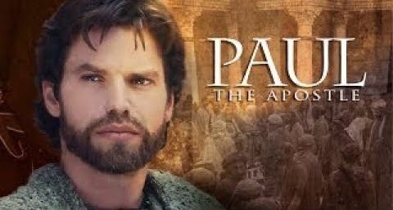
The Apostle Paul

Slide 15
What do we know about Paul from Scripture?
Group 1: Acts 9:1-19; 22:3-21; 26:1-18
Group 2: Gal. 1:11-17; 1 Cor. 9:1; 15:8-9; Phi. 3:4-7
What can we learn about Paul from these texts?
How did he know/experience Jesus?
How did his call experience affect him?

Slide 16

2 Corinthians 11:16-12:10
How did Paul view suffering for his faith?

Slide 17
Paul’s Impact
- Paul sometimes butted heads with Peter and other Jewish Christians because of his zeal for sharing the Gospel with the Gentiles.
- Many scholars believe that Paul shaped the Church as much or more than Jesus since Paul’s letters were circulated decades before any of the gospels. It was Paul who interpreted the meaning of the cross as forgiveness of sins, Jesus as the second Adam, and his Resurrection as marking a New Creation. For good or for ill, none of Paul’s letters describe Jesus’ life and teachings.

Slide 18
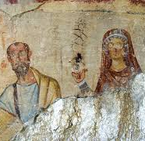
The Acts of Paul and Thecla
According to this non-canonical 3rd or 4th century text, Paul was not attractive physically. He was “a man small in size, bald-headed, bandy-legged, well-built with eyebrows meeting, [and] rather long-nosed.”

Slide 19
Last long journey…
Paul was ultimately arrested and taken to Caesarea. The governor there, Felix, was acquainted with Christianity and dismissed the false charges against him. But he still held Paul in custody for 2 years. In 59 C.E. Felix was replaced by Festus as governor who wanted to return Paul to Jerusalem. Paul insisted on a hearing before the emperor in Rome- his right as a Roman citizen. Herod Agrippa II and his sister Bernice visited Paul during this time, and agreed to send him to Rome.
Paul’s ship to Rome was caught in a major storm after leaving Crete and broke apart off Malta. All on board survived. He stayed in Malta through the bad weather and then continued to Rome in the spring of 60 C.E. For a time, he resumed his mission work there, but eventually was arrested. He was tried, released, and then rearrested again in approximately 67 C.E., this time accused of a capital offense. According to tradition, he was beheaded in Rome. He was less than 60 years old at the time.

Slide 20
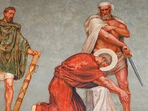

Slide 21
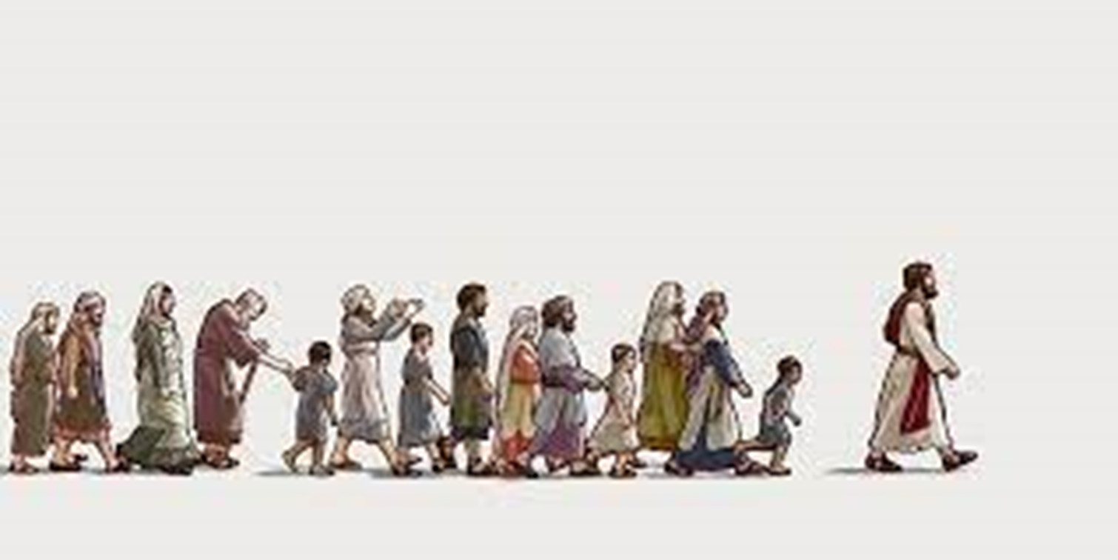
Reflections and Conclusions

Slide 22
Who were among the followers of Christ?
Peter Barnabas Philip
James Z. Matthias Priscilla
John Z. Joanna Phoebe
Mary (mother of Jesus) Mary wife of Clopas Matthew
Mary of Bethany Joseph of Arimathea Mary Magdalene
Martha of Bethany Lydia James the Lesser
Lazarus of Bethany Nathaniel Simon the Zealot
Andrew Thomas Judas not Iscariot
Judas Iscariot Stephen Paul
Susanna

Slide 23
Who were the followers of Christ?
Fishermen Political radicals Doubters
Housewives Jews and Gentiles Rebels
Scholars illiterates Peacemakers
Business women Samaritans Young and old
Tax collectors Gentle mama’s boys Encouragers
Data collectors Mothers
Rich and powerful Courageous, self-sacrificing people
Poor and vulnerable (demon possessed or ill)

Slide 24
U.A. Fanthorpe’s Getting It Across.
This is the hard thing.
Not being God, the Son of Man,
—I was born for that part—
But patiently incising on these yokel faces,
Mystified, bored and mortal,
The vital mnemonics they never remember....
They know my unknowable parables as well
As each other’s shaggy dog stories.
I say! I say! I say! There was this Samaritan,
This Philistine and this Roman…or
What did the high priest say
To the belly dancer? All they need
Is the cue for laughs. My sheep and goats,
Virgins, pigs, fig trees, loaves and lepers
Confuse them. Fishing, whether for fish or men,
Has unfitted them for analogy.
Yet these are my mouths. Through them only
Can I speak with Augustine, Aquinas, Martin,
Paul
Regius Professors of Divinity,
And you, and you...
I envy Moses, who could choose
The diuturnity of stone for waymarks
Between man and Me. He broke the tablets,
Of course. I too know the easy messages
Are the ones not worth transmitting;
But he could at least carve...
I alone must write on flesh. Not even
The congenial face of my Baptist cousin,
My crooked affinity Judas, who understands,
Men who would give me accurately to the unborn
As if I were something simple, like bread.
But Pete, with his headband stuffed with fishhooks,
His gift for rushing in where angels wouldn’t,
Tom, for whom metaphor is anathema,
And James and John, who want the room at the top—
These numskulls are my medium. I called them.
I am tattooing God on their makeshift lives.
My Keystone Cops of disciples, always,
Running absurdly away, or lying ineptly,
Cutting off ears and falling into the water,
These Sancho Panzas must tread my Quixote life,
Dying ridiculous and undignified,
Flayed and stoned and crucified upside down.
They are the dear, the human, the dense, for whom
My message is. That might, had I not touched them,
Have died decent respectable upright deaths in bed.

Slide 25
What does this tell us about the Kingdom of God?
What does this tell us about how the Church should be?
Which disciples do you resonate with most?

Slide 26
Spiritual Gifts
We have all of the traits the first disciples did. We also are blessed with spiritual gifts as they were so that we can follow Jesus.
Do you know what your spiritual gifts are?

Slide 27
Biblical gifts
Administration
The gift of administration is the divine strength or ability to organize multiple tasks and groups of people to accomplish these tasks.
Luke 14:28-30; Acts 6:1-7; 1 Corinthians 12:28
Apostleship
The gift of apostleship is the divine strength or ability to pioneer new churches and ministries through planting, overseeing, and training.
Acts 15:22-35; 1 Corinthians 12:28; 2 Corinthians 12:12; Galatians 2:7-10; Ephesians 4:11-14
Craftsmanship
The gift of craftsmanship is the divine strength or ability to plan, build, and work with your hands in construction environments to accomplish multiple ministry applications.
Exodus 30:22, 31:3-11; 2 Chronicles 34:9-13; Acts 18:2-3
Discernment
The gift of discernment is the divine strength or ability to spiritually identify falsehood, to distinguish between right and wrong motives and the spiritual forces at work in situations.
Matthew 16:21-23; Acts 5:1-11, 16:16-18; 1 Cor. 12:10; 1 John 4:1-6

Slide 28
Evangelism
The gift of evangelism is the divine strength or ability to help non-Christians take the necessary steps to becoming a born-again Christian.
Acts 8:5-6, 8:26-40, 14:21, 21:8; Ephesians 4:11-14
Exhortation
The gift of exhortation is the divine strength or ability to strengthen, comfort or urge others to action through the written or spoken word and Biblical truth.
Acts 14:22; Romans 12:8; 1 Timothy 4:13; Hebrews 10:24-25
Faith
The gift of faith is the divine strength or ability to believe in God for unseen supernatural results in every arena of life.
Acts 11:22-24; Romans 4:18-21; 1 Corinthians 12:9; Hebrews 11
Giving
The gift of giving is the divine strength or ability to produce wealth and to give by tithes and offerings for the purpose of advancing the Kingdom of God on earth.
Mark 12:41-44; Romans 12:8; 2 Corinthians 8:1-7, 9:2-7 65

Slide 29
Healing
The gift of healing is the divine strength or ability to act as an intermediary in faith, prayer, and by the laying-on of hands for the healing of physical, mental and spiritual sickness.
Acts 3:1-10, 9:32-35, 28:7-10; 1 Corinthians 12:9, 28
Helps
The gift of helps is the divine strength or ability to work in a supportive role for the accomplishment of tasks in Christian ministry with the ability to often see the need before others do.
Mark 15:40-41; Acts 9:36; Romans 16:1-2; 1 Corinthians 12:28
Hospitality
The gift of hospitality is the divine strength or ability to create warm, welcoming environments for others in places such as your home, office, or church.
Acts 16:14-15; Romans 12:13, 16:23; Hebrews 13:1-2; 1 Peter 4:9
Intercession
The gift of intercession is the divine strength or ability to stand in the gap in prayer for someone, something, or someplace, believing for profound results.
Hebrews 7:25; Colossians 1:9-12, 4:12-13; James 5:14-16

Slide 30
Word of Knowledge
The gift of knowledge is the divine strength or ability to bring truth to a situation by supernatural revelation. This is often accompanied by a word from God. Acts 5:1-11; 1 Corinthians 12:8; Colossians 2:2-3
Leadership
The gift of leadership is the divine strength or ability to influence people at their level while directing and focusing them on the big picture, vision, or idea. Romans 12:8; 1 Timothy 3:1-13, 5:17; Hebrews 13:17
Mercy
The gift of mercy is the divine strength or ability to feel empathy and to care for those who are hurting in any way. Matthew 9:35-36; Mark 9:41; Romans 12:8; 1 Thess. 5:14
Tongues (and Interpretation)
The gift of tongues is the divine strength or ability to pray in a heavenly language to encourage your spirit and to commune with God. The gift of tongues is often accompanied by interpretation and should be used appropriately.
Acts 2:1-13; 1 Corinthians 12:10, 14:1-14
Word of Wisdom
The gift of wisdom is the divine strength or ability to understand and to bring clarity to situations and circumstances often through applying the truths of Scripture in a practical way.
Acts 6:3,10; 1 Corinthians 2:6-13, 12:8

Slide 31
Miracles
The gift of miracles is the divine strength or ability to alter the natural outcomes of life in a supernatural way through prayer, faith, and divine direction.
Acts 9:36-42, 19:11-12, 20:7-12; Romans 15:18-19; 1 Corinthians 12:10, 28
Pastor/Shepherd
The gift of pastor/shepherd is the divine strength or ability to care for the personal needs of others by nurturing and mending life issues.
John 10:1-18; Ephesians 4:11-14; 1 Timothy 3:1-7; 1 Peter 5:1-3
Prophecy
The gift of prophecy is the divine strength or ability to communicate God's truth and heart in a way that calls people to a right relationship with God.
Acts 2:37-40, 7:51-53, 26:24-29; 1 Corinthians 14:1-4; 1 Thessalonians 1:5
Service
The gift of serving is the divine strength or ability to do small or great tasks in working for the overall good of the body of Christ.
Acts 6:1-7; Romans 12:7; Galatians 6:10; 1 Timothy 1:16-18; Titus 3:14
Teaching
The gift of teaching is the divine strength or ability to study and learn from the Scriptures primarily to bring understanding and depth to other Christians.
Acts 18:24-28, 20:20-21; 1 Corinthians 12:28; Ephesians 4:11-14

Slide 32

Spiritual Gifts Exercise
Find a partner you know (if possible).
What gifts do you see in each other? Share with one another.
Then take the survey and see if it confirms the gifts that they perceived in you.
If there is time, cross check the gifts the survey identified with your partner. Do they sound like you?

