Slide 1
Those Who Said “Yes” to Christ’s Call: The Saints and Sinners in our Spiritual Ancestry Session Three: March 16, 2023

Slide 2
SCHOLARS, MANAGERS, SPOKESPEOPLE
Philip
Nathanael
Thomas
Phoebe
Priscilla
Notes:
What do you already know about Philip, Nathanael, Thomas, Phoebe and Priscilla?

Slide 3
Your Questions to Ponder
Which of these scholars, managers, spokesperson would you want to take to lunch?
What would you talk about?
What would you ask them?

Slide 4
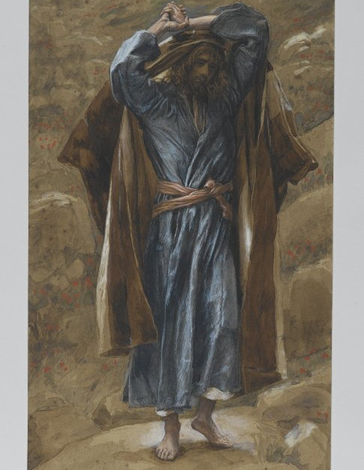
Philip
The
Chosen
James
Tissot
Notes:
Depictions from an early 20th century artist, James Tissot and a depiction from the series The Chosen. It was commented that in The Chosen all the disiciples look alike.

Slide 5
BUT JOHN’S GOSPEL HAS A DIFFERENT ACCOUNT
John 1: 43-51⁴³ The next day Jesus decided to go to Galilee. He found Philip and said to him, ‘Follow me.’ ⁴⁴ Now Philip was from Bethsaida, the city of Andrew and Peter. ⁴⁵ Philip found Nathanael and said to him, ‘We have found him about whom Moses in the law and also the prophets wrote, Jesus, son of Joseph from Nazareth.’ ⁴⁶ Nathanael said to him, ‘Can anything good come out of Nazareth?’ Philip said to him, ‘Come and see.’ ⁴⁷ When Jesus saw Nathanael coming towards him, he said of him, ‘Here is truly an Israelite in whom there is no deceit!’ ⁴⁸ Nathanael asked him, ‘Where did you come to know me?’ Jesus answered, ‘I saw you under the fig tree before Philip called you.’ ⁴⁹ Nathanael replied, ‘Rabbi, you are the Son of God! You are the King of Israel!’ ⁵⁰ Jesus answered, ‘Do you believe because I told you that I saw you under the fig tree? You will see greater things than these.’ ⁵¹ And he said to him, ‘Very truly, I tell you,^{[a]} you will see heaven opened and the angels of God ascending and descending upon the Son of Man.’
Notes:
John’s narrative about the calling of the disciples is different from the synoptic Gospels. What little do we learn about Philip from this passage?

Slide 6
Philip, The Practical
John 6:1-7
6 After this Jesus went to the other side of the Sea of Galilee, also called the Sea of Tiberias.^{[a]} ² A large crowd kept following him, because they saw the signs that he was doing for the sick. ³ Jesus went up the mountain and sat down there with his disciples. ⁴ Now the Passover, the festival of the Jews, was near. ⁵ When he looked up and saw a large crowd coming towards him, Jesus said to Philip, ‘Where are we to buy bread for these people to eat?’ ⁶ He said this to test him, for he himself knew what he was going to do. ⁷ Philip answered him, ‘Six months’ wages^{[b]} would not buy enough bread for each of them to get a little.’

Slide 7
Philip, the questioner
^{John 14:6-10}
⁶ Jesus said, ‘I am the way, and the truth, and the life. No one comes to the Father except through me. ⁷ If you know me, you will know^{[a]}my Father also. From now on you do know him and have seen him.’
⁸ Philip said to him, ‘Lord, show us the Father, and we will be satisfied.’ ⁹ Jesus said to him, ‘Have I been with you all this time, Philip, and you still do not know me? Whoever has seen me has seen the Father. How can you say, “Show us the Father”? ¹⁰ Do you not believe that I am in the Father and the Father is in me?

Slide 8
Philip, the Respected
John 12:20-22
²⁰ Now among those who went up to worship at the festival were some Greeks. ²¹ They came to Philip, who was from Bethsaida in Galilee, and said to him, ‘Sir, we wish to see Jesus.’ ²² Philip went and told Andrew; then Andrew and Philip went and told Jesus.
Notes:
This is long before Paul’s ministry to the Gentiles. Already in Jesus’ ministry one of the disciples has reached out to Gentiles who want to see Jesus. Philip as spokesperson!

Slide 9
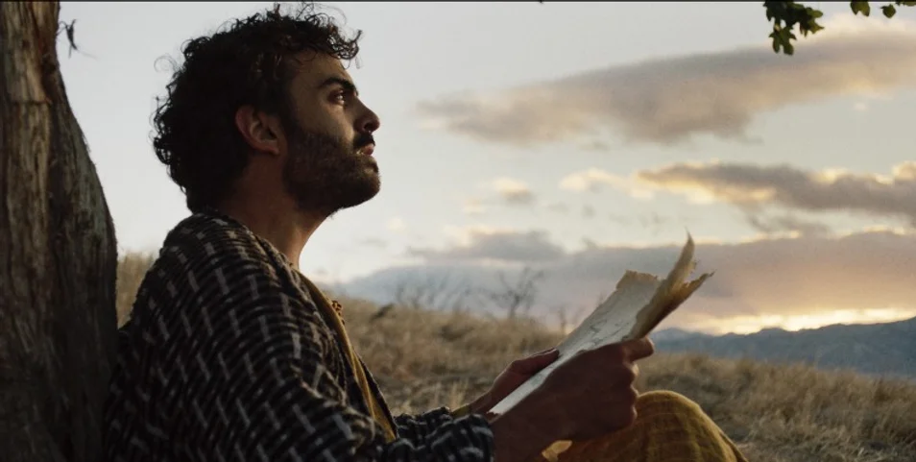
Nathanael
Notes:
Nathanael is very commonly depicted under a fig tree.

Slide 10
Scripture
^{John 1:43-51}
⁴³ The next day Jesus decided to go to Galilee. He found Philip and said to him, ‘Follow me.’ ⁴⁴ Now Philip was from Bethsaida, the city of Andrew and Peter. ⁴⁵ Philip found Nathanael and said to him, ‘We have found him about whom Moses in the law and also the prophets wrote, Jesus son of Joseph from Nazareth.’ ⁴⁶ Nathanael said to him, ‘Can anything good come out of Nazareth?’ Philip said to him, ‘Come and see.’ ⁴⁷ When Jesus saw Nathanael coming towards him, he said of him, there is no deceit!’ ⁴⁸ Nathanael asked him, ‘Where did you come to know me?’ Jesus ‘Here is truly an Israelite in whom answered, ‘I saw you under the fig tree before Philip called you.’ ⁴⁹ Nathanael replied, ‘Rabbi, you are the Son of God! You are the King of Israel!’ ⁵⁰ Jesus answered, ‘Do you believe because I told you that I saw you under the fig tree? You will see greater things than these.’ ⁵¹ And he said to him, ‘Very truly, I tell you,^{[a]} you will see heaven opened and the angels of God ascending and descending upon the Son of Man.’
Notes:
Let’s go back to John 1: 43-51 and look at the insight we get into Nathanael. 1) Skeptical at first 2) Jesus sees his devotion to the Torah. It is Nathanael’s heart and soul 3) ”Under the fig tree” is known as a metaphor for one very devoted to the study of the law. 4) A very powerful profession of faith from Nathanael 5) A calling from Jesus that anticipates more of what’s ahead

Slide 11
Things to Consider and Tradition
Nathanael is only mentioned in John’s Gospel
(Are Nathanael and Bartholomew the same person?)
Was Nathanael the beloved disciple at the cross?
Philip was considered to be an avid preacher. (We know he was seen as a leader among the Greeks according to scripture.)
Both Philip and Nathanael (Bartholomew) were crucified upside down in Hierapolis,(modern day Turkey, but Philip continued preaching from the cross. What happened to Nathanael?
Notes:
Tradition holds that Nathanael (Bartholomew) was released.

Slide 12
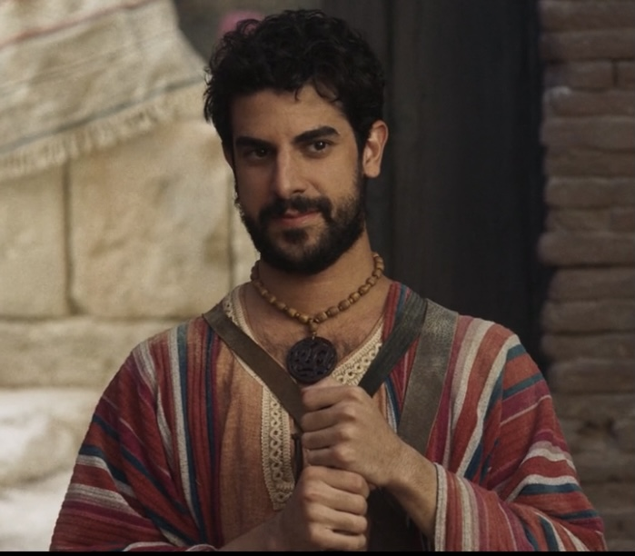
Thomas
Notes:
What the most well known story about Thomas? Is it possible to cast Thomas in a different light?

Slide 13
Scripture
^{John 11:7-16}
⁷ Then after this he said to the disciples, ‘Let us go to Judea again.’ ⁸ The disciples said to him, ‘Rabbi, the Jews were just now trying to stone you, and are you going there again?’ ⁹ Jesus answered, ‘Are there not twelve hours of daylight? Those who walk during the day do not stumble, because they see the light of this world. ¹⁰ But those who walk at night stumble, because the light is not in them.’ ¹¹ After saying this, he told them, ‘Our friend Lazarus has fallen asleep, but I am going there to awaken him.’ ¹² The disciples said to him, ‘Lord, if he has fallen asleep, he will be all right.’ ¹³ Jesus, however, had been speaking about his death, but they thought that he was referring merely to sleep. ¹⁴ Then Jesus told them plainly, ‘Lazarus is dead. ¹⁵ For your sake I am glad I was not there, so that you may believe. But let us go to him.’ ¹⁶ Thomas, who was called the Twin,^{[c]} said to his fellow-disciples, ‘Let us also go, that we may die with him.’
Notes:
Coming from Jerusalem, there was violence lodged against Jesus. the disciples did not want to go ack to Judea. Thomas is the one willing to accompany him even if it means sacrificing his life.

Slide 14
^{John 20:24-29}
²⁴ But Thomas (who was called the Twin^{[a]}), one of the twelve, was not with them when Jesus came. ²⁵ So the other disciples told him, ‘We have seen the Lord.’ But he said to them, ‘Unless I see the mark of the nails in his hands, and put my finger in the mark of the nails and my hand in his side, I will not believe.’
²⁶ A week later his disciples were again in the house, and Thomas was with them. Although the doors were shut, Jesus came and stood among them and said, ‘Peace be with you.’ ²⁷ Then he said to Thomas, ‘Put your finger here and see my hands. Reach out your hand and put it in my side. Do not doubt but believe.’ ²⁸ Thomas answered him, ‘My Lord and my God!’ ²⁹ Jesus said to him, ‘Have you believed because you have seen me? Blessed are those who have not seen and yet have come to believe.’

Slide 15
Things to Consider and Tradition
Not the writer of the Gospel of Thomas
The text about the post resurrection appearance is always used in worship the Sunday after Easter
Little is known about Thomas after the Ascension
Thomas traveled to India and established many churches and is known as the patron saint of India

Slide 16
Phoebe
Notes:
Depiction is from “Women and The Word” by Mary Lou Sleevi

Slide 17
Scripture
Romans 16:1-3
16 I commend to you our sister Phoebe, a deacon^{[a]} of the church at Cenchreae, ² so that you may welcome her in the Lord as is fitting for the saints, and help her in whatever she may require from you, for she has been a benefactor of many and of myself as well.

Slide 18
NO! NO! and NO! There’s no Greek feminine for deacon. Phoebe was a deacon, not a deaconess.
Notes:
What has been passed down about Phoebe is not actually the leader that is depicted in the scriptures.

Slide 19
SISTER
(Paul’s personal relationship to Phoebe.)
DEACON
(Phoebe’s leadership responsibility for the church in Cenchreae, likely a house church, a minister, church official serving the people)
BENEFACTOR
(Patron, protector, guardian, of means to support others financially)
Notes:
A lot of information about Phoebe in just three verses.

Slide 20
Things to Consider and Tradition
Scholars conclude that Phoebe was the person who delivered Paul’s letter to the Romans.
So, the Christians in Rome, read Paul’s letter. Then what?
Notes:
Phoebe would likely have been the person to have answered questions about Paul’s letter, had substantive conversation and Paul’s confidence in her as a colleague to do that.

Slide 21
Priscilla (Prisca)
Notes:
Depiction from ”Women of the Word” by Mary Lou Sleevi

Slide 22
Scripture
Acts 18:1-3
After this Paul^{[a]} left Athens and went to Corinth. ² There he found a Jew named Aquila, a native of Pontus, who had recently come from Italy with his wife Priscilla, because Claudius had ordered all Jews to leave Rome. Paul^{[b]} went to see them, ³ and, because he was of the same trade, he stayed with them, and they worked together—by trade they were tentmakers.
Notes:
Maybe vocation was actually leather rather than tents. Would not have much need for tents in the urban setting of Rome. Priscilla and Aquilla both involved in the family business, but priscilla may have done more of the travels with Paul.

Slide 23
Acts 18:18-28
¹⁸ After staying there for a considerable time, Paul said farewell to the believers^{[b]} and sailed for Syria, accompanied by Priscilla and Aquila. At Cenchreae he had his hair cut, for he was under a vow. ¹⁹ When they reached Ephesus, he left them there, but first he himself went into the synagogue and had a discussion with the Jews. ²⁰ When they asked him to stay longer, he declined; ²¹ but on taking leave of them, he said, ‘I^{[c]} will return to you, if God wills.’ Then he set sail from Ephesus.

Slide 24
²⁴ Now there came to Ephesus a Jew named Apollos, a native of Alexandria. He was an eloquent man, well-versed in the scriptures. ²⁵ He had been instructed in the Way of the Lord; and he spoke with burning enthusiasm and taught accurately the things concerning Jesus, though he knew only the baptism of John. ²⁶ He began to speak boldly in the synagogue; but when Priscilla and Aquila heard him, they took him aside and explained the Way of God to him more accurately. ²⁷ And when he wished to cross over to Achaia, the believers^{[f]} encouraged him and wrote to the disciples to welcome him. On his arrival he greatly helped those who through grace had become believers, ²⁸ for he powerfully refuted the Jews in public, showing by the scriptures that the Messiah^{[g]} is Jesus
Notes:
So, what insight do we get into Priscilla from this passage?

Slide 25
Romans 16:1-4
16 I commend to you our sister Phoebe, a deacon^{[a]} of the church at Cenchreae, ² so that you may welcome her in the Lord as is fitting for the saints, and help her in whatever she may require from you, for she has been a benefactor of many and of myself as well.
³ Greet Prisca and Aquila, who work with me in Christ Jesus, ⁴ and who risked their necks for my life, to whom not only I give thanks, but also all the churches of the Gentiles.
Notes:
“risked their necks” Went into places that may not have been friendly to what was being taught about Jesus.

Slide 26
Things to Consider and Tradition
Priscilla’s name is always listed first.
Paul listed Priscilla and Aquilla in introductions to many of his letters which means they were known to these churches.
It is thought that Priscilla was a woman of means, but that Aquilla had been raised as a slave.

Slide 27
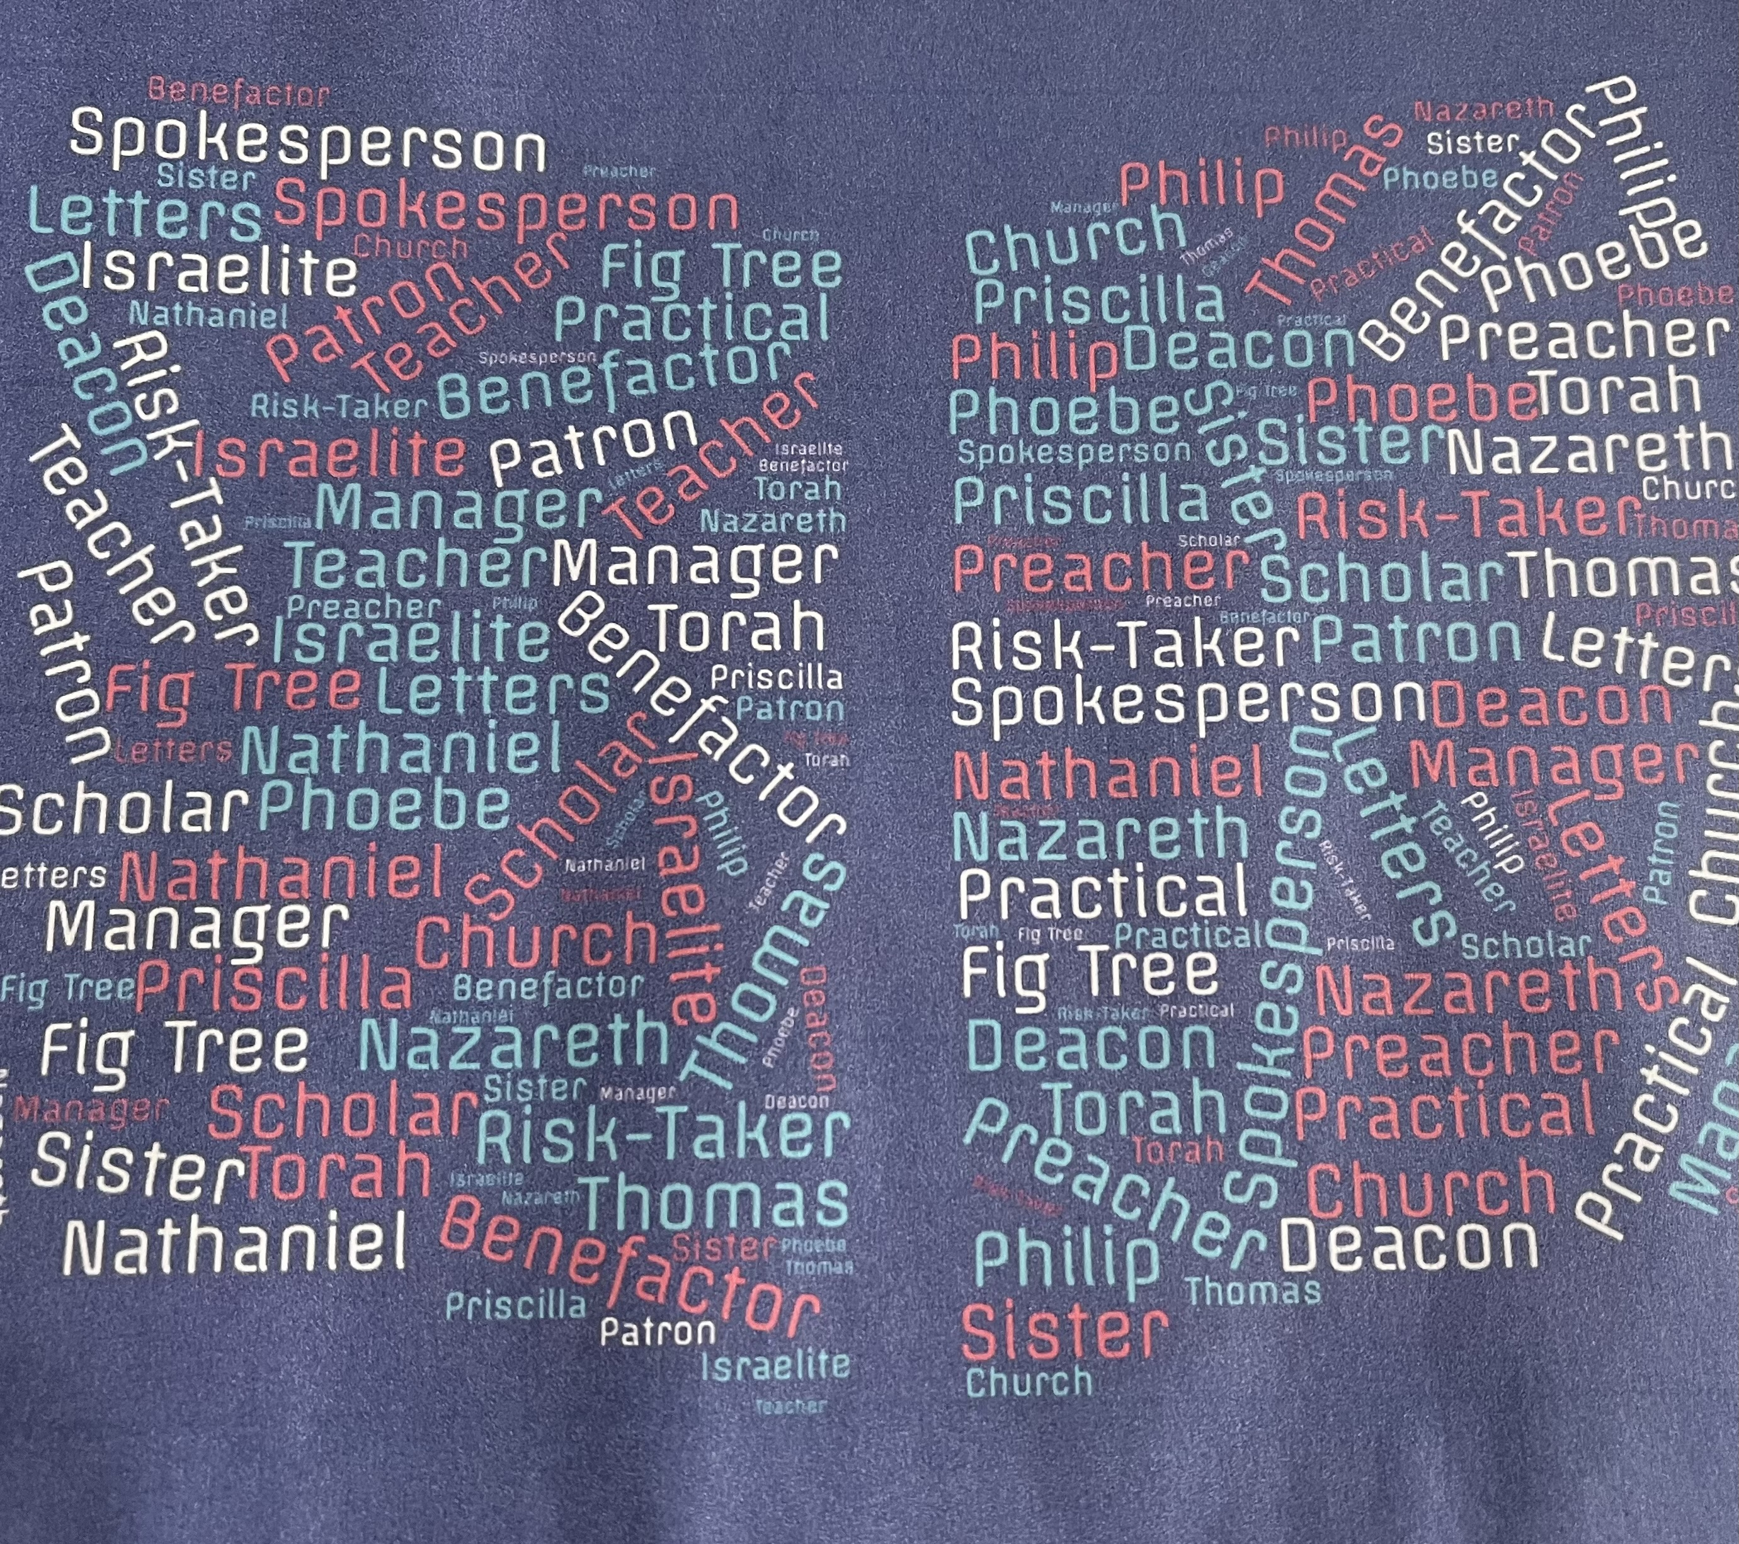
Scholars Managers Spokespeople Look at some of the characteristics we have discussed.

Slide 28
So…..
Who do you want to take to lunch?
What would you talk about?
What would you ask them?

