Slide 1
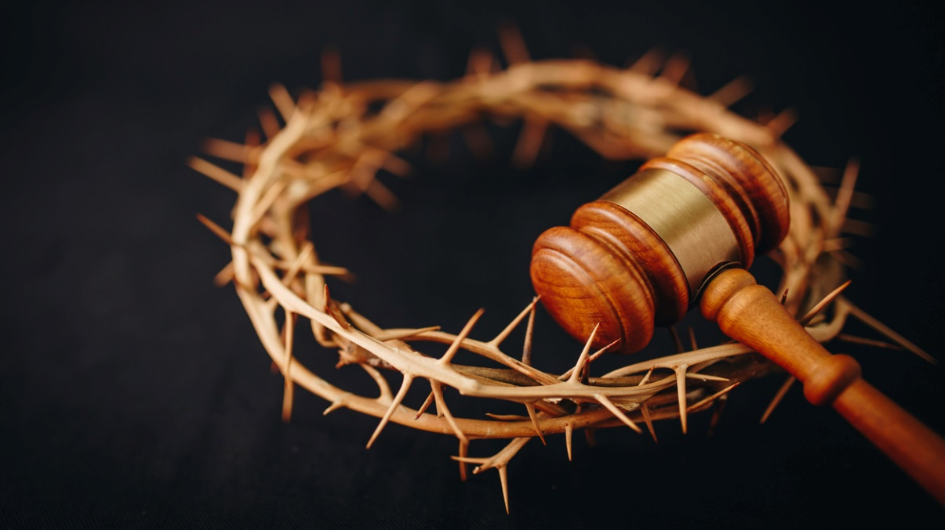
Reformed and Ever Reforming: An Exploration of Evolving Understandings of Christ's Saving Work on the Cross
by Pastor Elizabeth McLean
& Parish Associate Dottie LaPenta
Soup and Scripture 2024

Slide 2
Class One- An Introduction
Opening prayer
Opening Sharing:
What does Jesus’ death on the cross mean to you?
Do you believe he had to die that way? Why?
What does it mean to be saved?
What does it mean to you to be part of “God’s chosen people” or elected for salvation?”

Slide 3
These questions are addressed by two core Christian doctrines
The Doctrine of Atonement affirms that Jesus had to die to save humanity and therefore did by God’s grace. To be “saved” typically is understood to mean being spared condemnation and punishment by God in this life and the next for our sins.
The Doctrine of Election (or Predestination) affirms that God alone has the power to save humanity; humanity cannot save itself. Therefore, who is saved and how is also up to God alone.

Slide 4
Part I- Atonement or At-One-Ment
a term coined in the 16th Century to describe the event or process made known through the Gospel by which sinful humanity’s relationship with God was eternally transformed through Christ.
based upon the belief that humankind was in a dire predicament of some kind as a result of the presence of sin in the world, and that somehow Jesus Christ God resolved that predicament.
The exact nature of the predicament and the way it was resolved, however, can be understood in many different ways.

Slide 5
Exploring Atonement Theory- Past and Present
Class One- Introduction to atonement imagery in the New Testament
Class Two- Penal Substitution Theory- history, strengths and criticisms
Class Three- Alternative understandings (both ancient and modern) of the meaning of Jesus’ death on the cross and/or how he “saves,” frees, and transforms us.

Slide 6
Confession of 1967
God’s reconciling act in Jesus Christ is a mystery which the Scriptures describe in various ways. It is called the sacrifice of a lamb, a shepherd’s life given for his sheep, atonement by a priest; again, it is ransom of a slave, payment of a debt, vicarious satisfaction of a legal penalty, and victory over the powers of evil. These are expressions of a truth which remains beyond the reach of all theory in the depths of God’s love for humankind. They reveal the gravity, cost, and sure achievement of God’s reconciling work. ¶9.09

Slide 7
The Biblical Witness
Metaphors used in the New Testament come from the five dominant realms of thought or practice operating within public life in ancient Palestine, and the larger Greco-Roman world:
the legal system (which inspired “justification” language)
business and commerce (which inspired “redemption” language)
personal relationships (which inspired “reconciliation” language),
worship (which inspired “sacrifice” language); and
cosmology/creation ideology (which inspired the “battle with evil” and new creation language.)

Slide 8
The Synoptic Gospels (and The Book of Acts)
1) “The Son of Man came not to be served but to serve, and to give his life as a ransom for many.” (Mk. 10:45/ Matt. 20:28) See also Mk. 14:22-25/Matt. 26-29/Luke 22:19-20; Ps. 49:8; Hos. 13:14.
*Note that “ransoming” in their day had little or nothing to do with kidnapping and everything to do with freeing people from slavery by paying to set them free. “Redeem” is a synonym for this concept.
2) “This is my blood of the covenant, which is poured out for many.” Mk. 14:24.
It was part of Hebrew tradition to offer a sacrifice to “seal a deal” or solemnize a covenant. (In fact, in Hebrew, the verb for “to make or enter into a covenant” is literally “to cut” a covenant. See e.g., Ex. 24:6-8). This interpretation holds that Jesus was the sacrifice whose blood sealed the new covenant he offered in the Last Supper. He was offering the people the means by which to claim a new freedom through God’s forgiveness of sin, and a new, eternally lasting covenantal identity through his death on the cross.
*Note this interpretation does not necessarily mean that God needed bloodshed and human sacrifice in order to give the people a new covenant identity or eternal life, only that the human expectation was that a sacrifice was necessary for the covenant to be true and lasting.

Slide 9
Extra dimension in Luke
Although Luke does refer to ransom, like the other Synoptic gospel writers, and affirms that Jesus provided forgiveness for human sins on the cross, his gospel adds an additional dimension to how Jesus’ provides salvation and transformation that the others do not. For Luke, Jesus’ death alone is not the source of humanity’s salvation. It is the cumulative witness of Jesus’ life, death, and resurrection which provide transformation by affirming God’s loving presence with us despite our sinfulness in suffering, injustice, and death.
Scholars call Luke’s approach the “soteriology of with-ness.” (Soteriology means the doctrine or method of saving). Jesus revealed that God is with us always, offering love not condemnation, and new life in this world and the next.

Slide 10
Johannine Texts
John’s Gospel and letters use numerous metaphors to convey the significance of Christ’s life, death and resurrection:
light vs dark,
Jesus as antidote to the poison of sin (John 3:14),
Jesus as “the bread from heaven” (John 6)
Jesus as the sacrificial lamb for Passover (John 1:29; 1 John 4:10 + Revelation)
Jesus as the Good Shepherd (John 10:14-18).
Jesus as the payment for humanity’s debts (John 11:50-52), and
Jesus as a sacrifice for human sin like the sin offering (Lev. 5:5-10) and/or the scapegoat used on Yom Kippur.

Slide 11
Paul
Paul also used numerous images taken from the contexts of law, business, worship, and creation to convey the significance of the cross. He speaks of:
reconciliation (2 Cor. 5:18-20)
vicarious substitution for humanity (2 Cor. 5:14-15; Gal. 3:13),
ransom of a slave (1 Cor. 6:20),
payment of a debt (Rom. 5:8-9, 6:23),
representation of humanity (2 Cor. 5:14, 21; Gal. 3:10-14),
sacrifice (2 Cor. 5:21; Gal. 3:13; Rom. 3:23-25),
justification (Rom. 5; Gal. 3:11),
forgiveness (2 Cor. 5:19),
new creation (2 Cor. 5:16-17),
adoption (Gal. 3:26-29)
triumph over cosmic powers (1 Cor. 15:54-57; Gal. 6:15).

Slide 12
Different audiences…
Appealing to Jews, Paul describes Christ as the second Adam (Rom. 5) giving birth through his death and resurrection to a new creation which is still unfolding.
Appealing to Gentiles and Stoics, he describes the cross as divine wisdom which reveals the foolishness of the world’s wisdom. (1 Cor. 1).
In all of these images, Paul makes clear that the saving action of Christ was to reconcile humanity with God, not God with humanity. God was never estranged from us, and never stopped loving humankind. It was humankind that separated itself from God through its sinfulness. But through his example and his sacrifice, Christ provided the means by which we are reconnected to God and one another.

Slide 13
Non-Pauline Letters and Epistles
The same metaphors which appear in the gospels and Pauline letters also appear in other New Testament texts. But in these later letters, the dominant metaphor is that of sacrifice. Jesus was sacrificed for our sins.
Hebrews provides a unique perspective, making Jesus both the ultimate sacrifice, and the priest who accomplishes it.
In the letters of Peter, Jesus’ sacrifice was not so much to give us eternal life as to heal us and enable us to live righteous lives in this world by following his example.

Slide 14
Philippians, Colossians, and Ephesians
More than other New Testament texts, these epistles focus on the nature of Christ being an essential part of how he saved humanity.
Philippians notes that Jesus had to empty himself of his divine power to take on human form- a concept called kenosis. (Phil. 2: 5-11).
Ephesians and Colossians explain that Jesus did this to provide humanity with the gift which God had predestined to offer us before time so that we might become adopted children of God and devote our lives to God’s service, worship, and praise. (Eph. 1).
This leads to the doctrine of election….

Slide 15
PREDESTINATION The Doctrine of Election

Slide 16
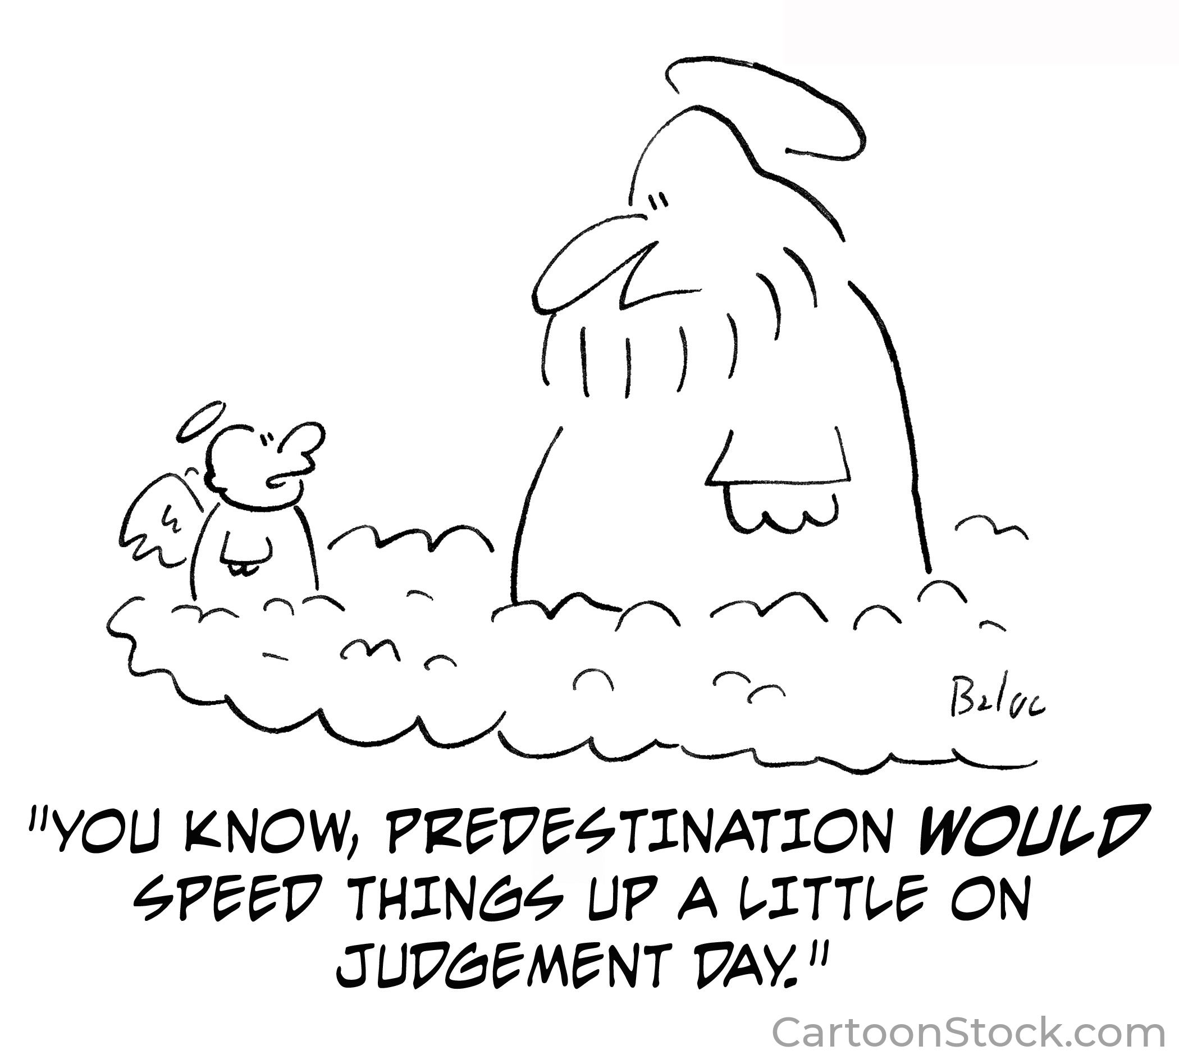

Slide 17
How did predestination come to be associated with the Reformed tradition?
”As scripture then, clearly shows, we say that God once established by his eternal and unchangeable plan those whose whom he long before determined once for all to receive into salvation, and those whom on the other hand he would devote to damnation. “
The Institutes of the Christian Religion 2 John Calvin, Chapter 21 #7

Slide 18
And so on….
By the decree of God for the manifestation of his glory, some men and angels are predestined unto everlasting life and others foreordained to everlasting death.”
The Westminster Confession of Faith , Chapter 3, 1647.

Slide 19
But also…..
SOVEREIGNITY OF GOD
”By predestination, we mean the eternal decree of God by which God determines his desires with regard to mankind.”
Institutes of Religion 2 John Calvin

Slide 20
Therefore…..
The Doctrine of Election
The Doctrine of “Choosing”
God’s choosing always precedes our choosing.
The scope of salvation is God’s business.
So, how will we approach this business of salvation that is God’s alone?

Slide 21
With Scripture…….
WEEK 5:
Let’s begin with Cain and Abel
Abraham, For the Sake of Blessing
Assurance at Sinai, Ongoing Covenant: Chosen for What?
WEEK 6:
The Prophets and the Call to Come Home
Jesus, the Elected One
Election goes to Church and into the World
Who saves? God saves!

Slide 22
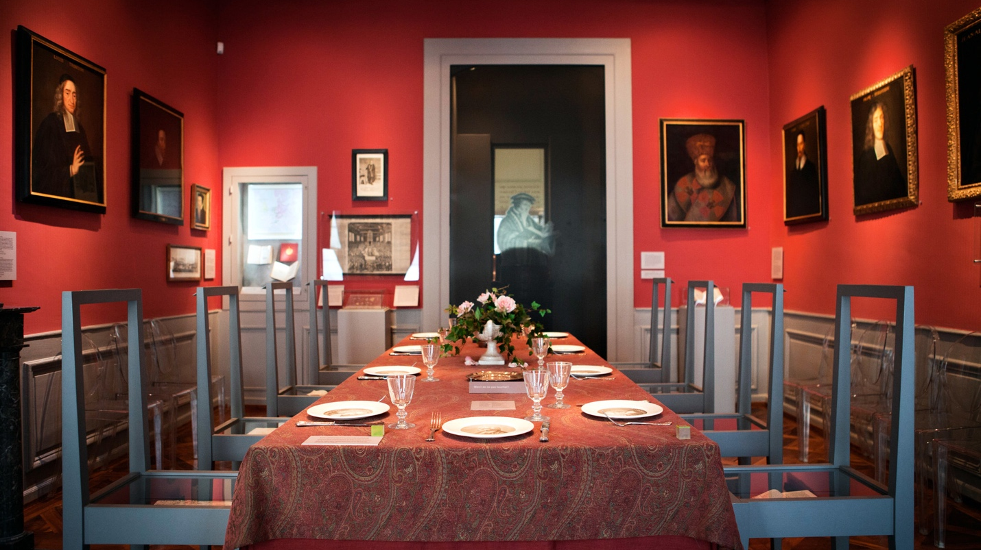
The dining room at the International Museum of the Reformation

