Slide 1
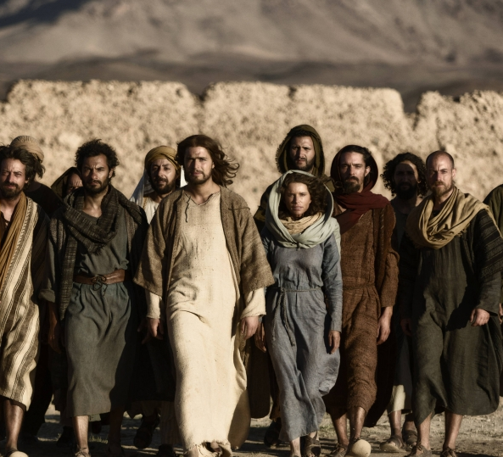
Those who said ‘Yes’ to Christ’s call:
The Saints and Sinners in our Spiritual Ancestry and in Us
Soup & Scripture March 2023
Rev. Elizabeth D. McLean

Slide 2
John 1 and the unnamed disciple

Slide 3
³⁵ The next day John again was standing with two of his disciples, ³⁶ and as he watched Jesus walk by he exclaimed, “Look, here is the Lamb of God!” ³⁷ The two disciples heard him say this, and they followed Jesus. ³⁸ When Jesus turned and saw them following, he said to them, “What are you looking for?” They said to him, “Rabbi” (which translated means Teacher), “where are you staying?” ³⁹ He said to them, “Come and see.” They came and saw where he was staying, and they remained with him that day. It was about four o’clock in the afternoon. ⁴⁰ One of the two who heard John speak and followed him was Andrew, Simon Peter’s brother. ⁴¹ He first found his brother Simon and said to him, “We have found the Messiah” (which is translated Anointed^{[a]}). ⁴² He brought Simon^{[b]} to Jesus, who looked at him and said, “You are Simon son of John. You are to be called Cephas”^{[c]} (which is translated Peter^{[d]}).
(John 1:35-42 NRSVUE)

Slide 4
Finding Your Roots

Slide 5
Disciple
Definition: A learner or student (from the Greek mathetes). In the canonical gospels this term is used to refer to twelve men whom Jesus chose as his closest followers and/or who asked to learn from and follow him.
Also, more generally, the term means followers of Jesus who believed in him, learned from him, and tried to follow his way. Luke 10 speaks of Jesus sending out seventy such disciples on a mission of evangelism and healing. All four gospels also mention a core group of women who remained with Jesus all the way to the cross. The Book of Acts also refers to some of the people who believed the good news of the Gospel as “disciples” as well.
This class will explore the stories of all these different types of disciples, not just the Twelve. All of these people could also be called “apostles”, which means “those who have been sent,” because Jesus sent everyone to share the good news.

Slide 6
Syllabus
Session One - DISCIPLES IN THE INNER CIRCLE
Session Two - EVANGELISTS, ENCOURAGERS, AND EQUIPPERS: Andrew, Barnabas, Matthias, Joanna, Susanna, Mary (wife of Clopas), Joseph of Arimathea, Lydia
Session Three - SCHOLARS, MANAGERS, AND SPOKESPEOPLE: Nathaniel, Thomas, Philip, Priscilla, Phoebe
Session Four - OUTCASTS AND OUTLIERS: Matthew, Mary Magdalene, “Three-word” disciples: James the Lesser, Simon the Zealot, Judas (not Iscariot)
Session Five - MARTYRS FOR A CAUSE: Judas Iscariot, Stephen, Paul; Spiritual Gifts & Conclusions

Slide 7
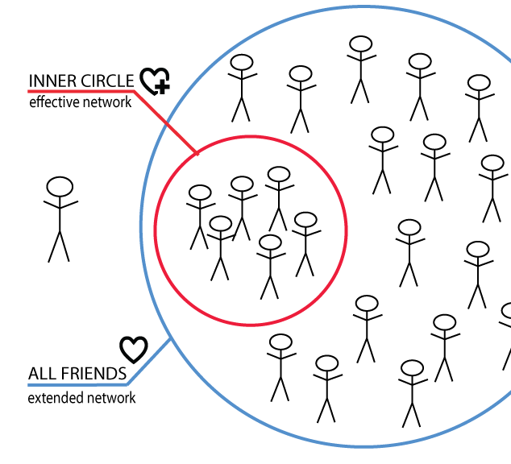
Jesus’ inner circle- The disciples he favored most
Peter
James and John Zebedee
Mary (his mother)
Mary, Martha and Lazarus of Bethany

Slide 8
Mary Mother of Jesus

Slide 9
Scripture lessons
Luke 1:26-56; 2:41-51;
John 2:1-12
(Non-canonical Infancy Gospel of James- immaculate conception)
What can we learn about Mary from these texts? What were her best qualities as the first disciple?

Slide 10
Qualities
Best Qualities: Obedient to God, courageous, loving, trusting, faithful to the end
Weaknesses? None really mentioned other than possible concern that Jesus was going crazy at one point in his ministry, and possibly pushing the start of his ministry in John.

Slide 11
Simon peter

Slide 12
From Adam Hamilton’s Book Simon Peter: Flawed but faithful disciple
“Most of the twelve disciples are scarcely mentioned by name in the Gospels. The disciple believed to be the “beloved disciple,” John, is mentioned about twenty times by name in the Gospels, as is Judas Iscariot who betrayed Jesus. Andrew, Simon Peter’s brother, is mentioned twelve times. Thomas the doubter is mentioned ten times. Bartholomew, James the son of Alphaeus, Simon the Zealot (also know as Simon the Cananaean), and Thaddaeus (also known as Judas son of James) are mentioned only three times each. Simon Peter, on the other hand, is mentioned by name of 120 times. Peter is not only mentioned more often than the other apostles in the Gospels, he is the leading figure among the twelve in the first half of the Acts of the Apostles.”

Slide 13
Some key stories:
Mark 1:16-20 (call of disciples); 8:27-38 (declaration that Jesus was the Messiah); 9:2-8 (Transfiguration)
Matt. 14:22-23 (walking on water with Jesus); 26:31-35 (Peter’s denial foretold), 69-75 (Peter’s denial of Jesus)
John 20:1-10 (race to the tomb); 21:15-19 (“Feed my sheep” conversation with risen Christ.)
Acts 2:1-4 (Pentecost sermon); Acts 10 (dream of unclean food)

Slide 14
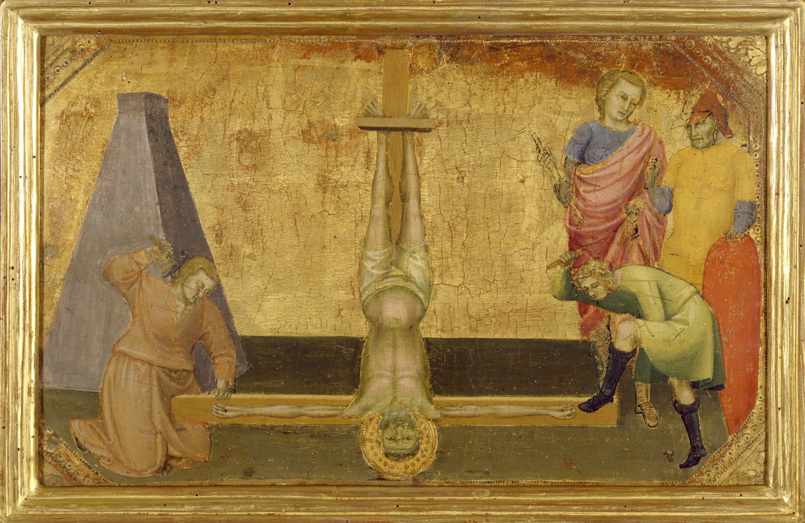
Tradition
Tradition holds that Peter was caught in the wave of persecution in Rome that followed Emperor Nero’s blaming Christians for the fires in Rome for which he was responsible. Many Christians were arrested and/or killed during this time. Scholars place Peter’s incarceration and death as October 64 C.E. According to the oldest traditions, Peter was taken to Caligula’s Circus, a large track where chariot races were held. There he was crucified. According to a non-canonical text, The Acts of Peter, Peter begged those who were preparing him for his death to crucify him upside- down to distinguish his earthly self from Christ’s heavenly self. His bones were buried near there. In the 1940s a set of bones wrapped in purple cloth in a white marble box were discovered buried deep under St. Peter’s Basilica, which was built on the spot where he was supposedly buried.

Slide 15
What do you think were Peter’s strongest qualities?
What were his “growing edges”?
Is Peter a model of faithful discipleship for us- why or why not?

Slide 16
Strengths/ Gifts/ Weaknesses and growing edges
Deeply dedicated, insightful, courageous, good leader, open to the work of the Spirit, ultimately humble and self-sacrificing
Foot-shaped mouth, lack of faith under pressure, arrogance

Slide 17
James and John Zebedee (Sons of Boangernes)

Slide 18
Scripture lessons
John 1:35-49 James and John were among the first disciples to be called. They worked for their father’s fishing business in Galilee.
Luke 9:51-56 (reaction to Samaritan village); Mark 10:35-40 (request for best seats);
John 19:25-27 (foot of the cross); John 20:1-10 (race to the tomb)
Acts 12: 1-2 (Martyrdom of James)
John and James, along with Peter got to see things the others did not: the healing of Jairus’ daughter and the Transfiguration.

Slide 19
Tradition
Jesus called James and John “sons of Boanerges.” That word is not recognized by scholars today. Some say it contains the root words for “thunder” and have called them “sons of Thunder.” Others say the word is closer to “raging.” When Mark says they were called this, he does not explain why. Maybe they had loud or forceful personalities. Maybe this is an inside joke we no longer get.
History records that James was the first of the Twelve to be martyred, killed by Herod Agrippa’s sword in 44 C.E.. Legend says that James’ body ended up in Santiago, Spain after floating miraculously in an unguided boat through the Mediterranean, around the Iberian Peninsula to the coast of Galicia. The remains were purportedly buried there, and then rediscovered 600+ years later when shepherds were given a vision of stars gathered over a field. Compostella means “field of stars.” The area was exhumed, and a cathedral built to house the remains. This marks the end of the pilgrimage trail across Spain called the Camino Way.

Slide 20
Many Christians throughout the ages have assumed that John was the “one whom Jesus loved” who wrote the Gospel of John and the 3 letters of John. Popular legend says he lived with Jesus’ mother Mary in Ephesus for a while, and that he is the only one of the Twelve who died of old age rather than martyrdom (in 98 C.E.). But other legends abound. One says he was killed by some fellow Jews, another that he was killed by being thrown into boiling oil, and a third that he did not die, but ascended into heaven like Elijah. Some legends associate him with “John of Patmos” who wrote the Book of Revelation while exiled there, although scholars now believe that was a different author.
Some people claim that James and John were Jesus’ cousins, sons of Salome, Mary’s sister. The Bible does not say either that they were cousins or that Mary had a sister named Salome, however. If this were true, it is possible and would explain why Jesus favored them. Although there are some inconsistences between the gospels, tradition says John was the younger of the two brothers.
Both James and John, along with Peter are described as “acknowledged pillars” of the Church in Galatians 2:9.

Slide 21
Strengths/ Gifts/ Weaknesses and growing edges
Strengths: Courageous, dedicated, resourceful, very faithful post-Resurrection
Growing edges: Ambitious to a fault, self-aggrandizing, short-tempered with non-believers

Slide 22
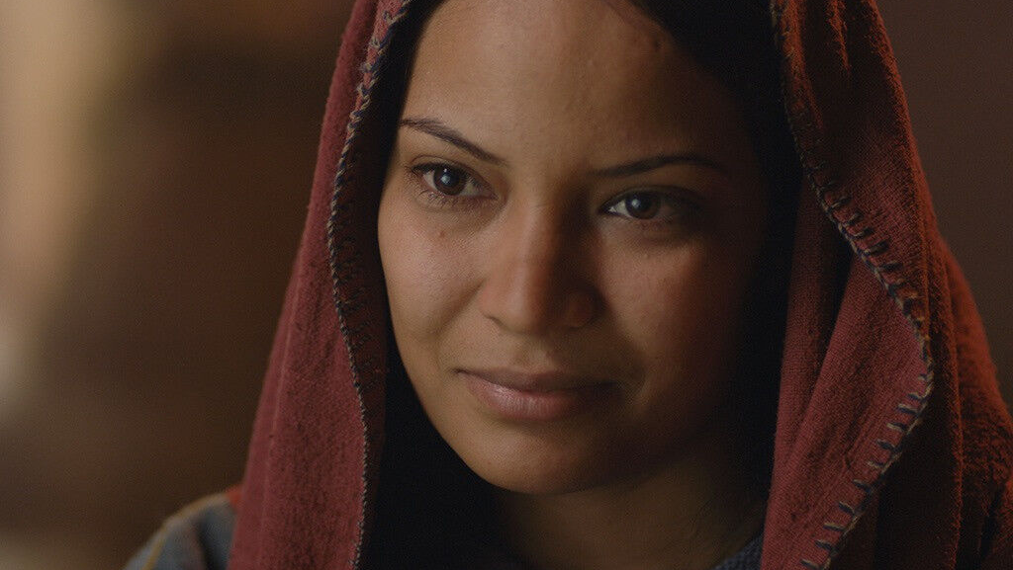
Mary and Martha of Bethany

Slide 23
Scripture lessons
Luke 10:38-42 (Entertaining Jesus)
John 11:1-5, 17-34 (Lazarus’ story)
John 12:3 (Jesus’ anointed with nard)

Slide 24
Tradition
Martha, Mary, and Lazarus were siblings who lived in Bethany near Jerusalem. Tradition says they were a wealthy family (because they had expensive perfume and a family tomb). The sisters are the only two women expressly described as being “loved by Jesus” (John 11:5)
Although Martha is a frenzied hostess in Luke, in John Martha is a prophet. She is the first character to name Jesus as the Messiah in the Gospel of John. (John 11:24-27) Mary is the first to recognize Jesus’ pending death and prepare him for it with her anointing. They were both women of great faith and insight.
In the Coptic version of the early second century Epistula Apostolorum, Martha is portrayed as a witness to the risen Christ and the first to tell the apostles about the Resurrection, rather than Mary Magdalene.

Slide 25
Traditions con’t.
According to legend, Martha left Judea after the Resurrection (around 48 C.E.) and went to Provence, France with her siblings. According to a 13th Century document called “The Golden Legend,” which confuses Mary, Martha’s sister with Mary Magdalene, they arrived there on a ship without sail, oars, or rudder. Once in France they converted many people to the faith. The Golden Legend gives the family a whole backstory complete with rich parents, multiple castles, and several successful battles with dragons and monsters.
Orthodox tradition distinguishes Mary, Martha’s sister from Mary Magdalene and identifies the former with the myrrh bearing women in addition to the latter. Orthodox tradition holds that when Mary's brother Lazarus was cast out of Jerusalem in the persecution against the Jerusalem Church following the martyrdom of Stephen, Mary and Martha also fled with him, assisting him in the proclaiming of the Gospel in various lands.

Slide 26
Strengths/ Gifts/ Weaknesses and growing edges
Ability to recognize Jesus for who he really was, dedication all the way to the foot of the cross, able to provide hospitality and pastoral care.
Martha- worried about “performance” or proving her value to Jesus. Tied to old roles.
Mary- prone to breaking social boundaries regarding women’s roles, public decorum, and fiscal responsibility

Slide 27
lazarus

Slide 28
John Chapter 11 + Tradition
Although John is the most popular candidate for the “one who Jesus loved” who wrote the Gospel of John, there is a second line of scholarship which argues that Lazarus is the one who Jesus loved, in large part because Lazarus is described using this language in John 11.
Lazarus was a target after his resuscitation as much as Jesus because so many people wanted to meet him his popularity and draw threatened the authorities.
One tradition holds that, after Jesus’ ascension back into heaven, Lazarus and his sisters moved to Cyprus where Lazarus became the bishop of Kition and died of natural causes in 63 C.E. The separate legend which says that the family went to France, reports that Lazarus was the bishop of Marseilles and was beheaded under the tyranny of Emperor Domitian.

Slide 29
Discussion
Which of these inner circle disciples reminds you most of yourself, if any?
Do you share any of the gifts these disciples had?
Do you share any of their weaknesses when it comes to your faith?
Why do you think Jesus kept these people so close or esteemed them so highly?
How do you feel about Jesus having favorites and/or close friends?
How can we learn from their mistakes?

Slide 30
Discussion Questions con’t.
Can you think of a time in your life when God was inviting you to “walk on water”? What about to stop your busyness and listen, or to recognize your pride and pursue something other than greatness, or to accept a call from God that put you way outside of the familiar and comfortable?
In what ways are you courageous in your faith? In what ways fearful?
In what ways do you cling to tradition? In what ways do you break boundaries?
How far outside your comfort zone have you stepped because of faith?
Is it OK for pastors to have “inner circle friends” in their flocks if Jesus did in his?

