Slide 1
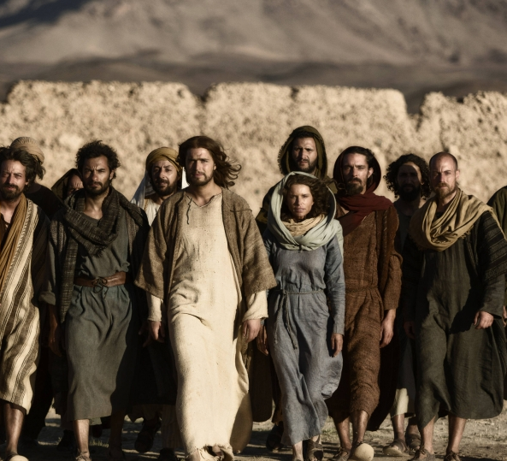
Those who said ‘Yes’ to Christ’s call:
The Saints and Sinners in our Spiritual Ancestry and in Us
Soup & Scripture March 2023
Rev. Elizabeth D. McLean

Slide 2
Opening sharing
1. Do you have a nickname? Who gave it to you and do you like it?
2. Are more or less religious than other members of your family or your friends? More or less political?
3. Do people constantly refer to you in relation to someone or something (i.e.- Bob’s wife; Susie’s daughter; Steve the Jogger; Joanne the advocate for X), or refer to something you were in the past but are not now?

Slide 3
Class Four
Outcasts and Outliers
Matthew, Mary Magdalene, and the “Three-word” disciples (Simon the Zealot, James the Lesser, and Judas not Iscariot)

Slide 4
Matthew- the Tax Collector
Matt. 9:9-13:
“As Jesus was walking along, he saw a man called Matthew sitting at the tax-collection station, and he said to him, ‘Follow me.’ And he got up and followed him. And as he sat at dinner in the house, many tax collectors and sinners came and were sitting with Jesus and his disciples. When the Pharisees saw this, they said to his disciples, ‘Why does your teacher eat with tax collectors and sinners?’ But when he heard this, he said, ‘Those who are well have no need of a physician, but those who are sick [do]. Go and learn what this means, ‘I desire mercy, not sacrifice.’ For I have not come to call the righteous but sinners.’”

Slide 5
What do we know about him?
Scripture lessons: Most of the references to Matthew in the New Testament are just in lists of disciples. Mark’s version of Jesus’ encounter with a tax collector calls him “Levi son of Alphaeus,” and does not include him among the Twelve. Luke’s gospel calls him simply “Levi.” Consequently, most scholars assume that Matthew and Levi were the same person. Whether he always had two names or whether Jesus “renamed” Levi “Matthew” we don’t know. But if they were one and the same, then Matthew may have been the brother of James the son of Alphaeus (aka “James the Less”). Scripture does not name them as brothers, however.
Tax collectors in Jesus’ day were despised by the Jews for two reasons: 1) they worked for those oppressing the Jews (either Herod or Rome); and 2) they typically made a profit for themselves by adding their own charges to the established levies. They were classified as “unclean” by the Jews. So, it was scandalous that Jesus would eat with them.

Slide 6
Traditions
According to Second Century tradition, Matthew the disciple/apostle was the author of the gospel called Matthew. Scholars now think this is unlikely. The author of the gospel clearly knew about the destruction of the Temple in 70. This would mean he was quite old when he wrote the gospel. But it is possible that whoever did write the gospel in Matthew’s name used earlier recollections from him. There are references to a Matthew written in Hebrew which has been lost.
Irenaeus (Against Heresies 3.1.1) and Clement of Alexandria say that Matthew the tax collector preached the Gospel to the Jewish community in Judea, before going to other countries, including Ethiopia. The Catholic Church and the Orthodox Church each hold the tradition that Matthew died as a martyr, and the Babylonian Talmud appears to report his execution in Sanhedrin 43a.
According to Church tradition, when he was in Ethiopia, Matthew converted Ephigenia, the virgin daughter of the Ethiopian King Egippus. When King Hirtacus succeeded Egippus, he asked the apostle if he could persuade Ephigenia to marry him. Matthew is said to have invited King Hirtacus to worship with him, only to rebuke him publicly there for lusting after the girl who had become a bride of Christ. The enraged King ordered his bodyguard to kill Matthew who stood at the altar at the time of his murder.

Slide 7
Mary magdalene

Slide 8
What do we know about her?
According to Luke (8:2), Mary was one of several women who followed Jesus after having been cured of “evil spirits and infirmities.” Luke reports specifically that Mary had been released from seven demons. This band of women who traveled with Jesus and the disciples witnessed the crucifixion from a distance, observed the tomb with Jesus’ body in position, and found the tomb empty when they went with burial spices. (Luke 23:49, 55-56; 24:1-9). Mary Magdalene, along with several others told the apostles about the resurrections (24:10); but the disciples did not believe them, and thought it was an idle tale.

Slide 9
According to Mark, Mary Magdalene was at the crucifixion (Mark 15:40), the tomb (Mark 15:47) and the empty tomb (Mark 16:1). Although she was with other women at these events, Mary Magdalene is always mentioned first among them, perhaps suggesting that Mark viewed her role as preeminent. According to the short ending of Mark, the women were too frightened to tell anyone about seeing the empty tomb. But according to the longer ending of Mark, the risen Christ first appeared to Mary Magdalene, who then went and told those who had been with him what had happened. But they would not believe her that Jesus was alive.
Matthew’s account of Mary Magdalene is very similar to that of Mark, except that the women are not as frightened in Matthew. They leave with joy to tell the disciples, are met by the risen Christ on the road, and take hold of his feet to worship him. Jesus sends them on to tell the others. (Matt. 28: 1, 9-10).

Slide 10
The Resurrection in John
In John, Mary Magdalene is not a key player until the resurrection. But after Jesus is crucified, it is Mary who alone rises early to go to the tomb to tend to Jesus’ body. Chapter 20 describes her encounter with Jesus. She is commissioned by Jesus to tell the others, and does so.
Not only is it significant that Jesus appeared to a woman first, and not to one of the disciples, it is significant that John of all people, would include this detail. John’s gospel is full of references to the “disciple whom Jesus loved.” The fact that he wasn’t cast as the star in the resurrection story all the more affirms the credibility of the gospel accounts that Jesus appeared to Mary (and/or other women) first.

Slide 11
Tradition
After about the 6th century, the Church began to associate Mary Magdalene with the sinful woman in L uke 7:36-50. People began referring to Mary as if she were a repentant or saved prostitute. But all the Bible says about Mary is that she had seven demons. It seems likely that as the Church over time grew uncomfortable with Mary’s prominence in the Resurrection story, they tried to diminish Mary’s authority some how by making her a woman of ill-repute.
Mary Magdalene is mentioned in several non-canonical texts. She appears in the 2nd Century Gospel of Peter as “a woman disciple of the Lord.”
The Coptic Gospel of Thomas reports a competition between Peter and Mary for Jesus’ affections. Peter says to Jesus “Let Mary leave us, for women are not worthy of Life.” Jesus responds, “I myself shall lead her in order to make her male, so that she too may/ become a living spirit resembling you males.”
In the 2nd Century Gospel of Mary (Magdalene), Mary plays a dominant role, communicating a secret revelation made to her by Jesus in a vision. When Andrew and Peter don’t believe her, a man named Levi defends her by describing her as “one made worthy by the Lord, known by him, and one loved by him even more than the disciples.”

Slide 12
Other stories
In the 3rd Century Pistis Sophia, Mary asks 39 out of the 64 questions addressed to Jesus. She is described as blessed, and as having a heart “more directed to the kingdom of heaven than all her brothers, excellent, blessed beyond all women, beautiful in speech, the pleroma of all pleromas*, the completion of all completions, superior to all the disciples.”
*the fullness of being of the divine life in Gnosticism
Stories and references to Mary Magdalene appear in several other gnostic texts we don’t need to get into here. Feminist theologians have argued that her role was diminished in the eyes of the church as it became more patriarch. But that being said, there is no evidence she was married to Jesus (as The DaVinci Code claims).

Slide 13
The “three-word” Disciples
James the Less(er) (aka James of Alphaeus)
Simon the Zealot
Judas not Iscariot (also known as Thaddeus and/or Jude the Apostle)

Slide 14
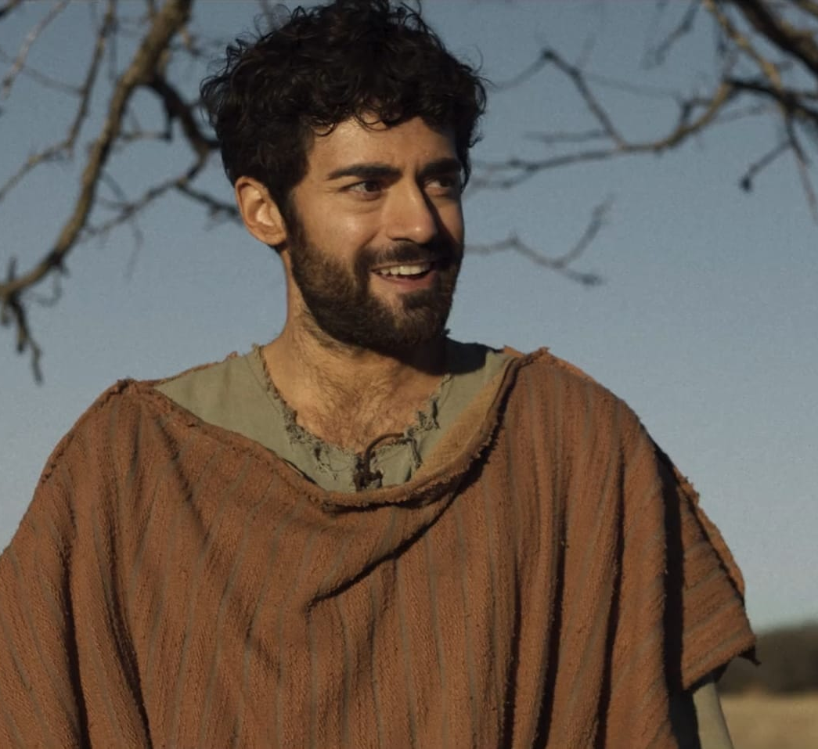
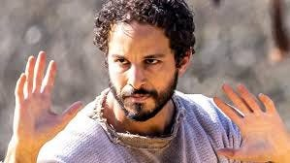
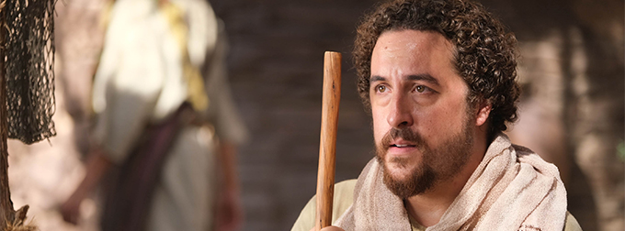

Slide 15
James the Less(er) /James of Alphaeus
Little is known of this James, who was not the same James as John Zebedee’s brother, and not the same James who was Jesus’ brother and became a leader in Jerusalem. Practically all we know about him is that he was the son of Alphaeus (Matthew 10:3; Mark 3:18; Luke 6:15; Acts 1:13).
In Mark 15:40, we learn that James's mother was named Mary. That verse, together with Matthew 27:56 and Mark 15:47, indicates that Mary has at least one more son besides James named Joses. Mary was one of the women who went to the tomb on Easter morning. Whether this means James came to faith through his mother or the other way around we do not know, nor do we know if Matthew/Levi was an additional brother to James apart from Joses (since Levi was also a son of Alphaeus.)

Slide 16
James’ Nickname
Mark 15:40 identifies James as “James the Less” or “James the Lesser.” In Greek the word is mikros which means “very little.”
This may mean that James was physically small, or that he was the younger of the two Jameses. It also could be a joke nickname, like “Little John” from Robin Hood. We don’t know.
He was the James who was not in the inner circle and known primarily by who his father was. So, he was less privileged and powerful than the other James.
Early church history is mostly as silent as the gospels about him. Some legends confuse him with Jesus’ brother. Some say he took the gospel to Syria and Persia. There are multiple accounts of his death, some of which say he was stoned, others that he was beaten to death, and others that say he was crucified.

Slide 17
Simon the zealot
Luke 6:15 lists a disciple called "Simon called the Zealot." In Matthew 10:4 and Mark 3:18, he is called "Simon the Cananaean." That is most likely not a reference to the “land of Canaan” or “the village of Cana,” but rather is a transliterated descriptive phrase based on the Aramaic root qanna, which means "to be zealous.”
The historian Josephus described four basic parties among the Jews in Jesus’ day: the Pharisees, the Sadducees, the Essenes, and the Zealots. The Zealots were the most politically motivated of the four. They hated the Romans and wanted to overthrow their occupation of Israel. The Zealots advanced their agenda through terrorism and surreptitious acts of violence until the time of the Jewish Revolution (which was after Jesus’ ascended). The fact that Simon was described as a Zealot, therefore, suggests that he was interested in overthrowing Rome, and may have followed Jesus under the assumption that he was also interested in ushering the Kingdom of God in a physical, political way.
The Zealots were convinced that paying tribute to a pagan king was an act of treason against God. This must have made for some lively dinner table conversation between Simon and Matthew!

Slide 18
What happened to him?
We don’t know if Simon fought in the rebellion with the other Zealots before the Temple fell, or if by that time he has been truly transformed by his time spent with the risen Christ. Some say that Judas Iscariot was also a Zealot who traveled with Simon when they paired off to share the Gospel. If Judas remained unchanged in heart, perhaps Simon became zealous for Christ instead. But little is known of what became of him. After the fall of the Temple in 70 C.E., legend says that Simon took the Gospel to the British Isles.

Slide 19
Judas (not Iscariot)/ Thaddeus/ jude the apostle
Although most Christians forget it, there were two Judases among the Twelve. John’s gospel cuts to the chase and calls the less famous one: “Judas (not Iscariot).” In Matthew 10:3, he is called "Lebbaeus, whose surname was Thaddaeus.” Both of these were probably nicknames. “Thaddaeus” means “breast child” and “Lebbaeus” means “heart child.” So, perhaps this Judas was thought of as a “Mammas’ boy” or was gentle in spirit. If so, it must have been interesting to watch him and Simon the Zealot respond to the suffering they saw around them.
This Judas speaks only once in the Bible. In John 14:21, Jesus says, "He who has My commandments and keeps them, it is he who loves Me. And he who loves Me will be loved by My Father, and I will love him and manifest Myself to him." Then John adds, "Judas (not Iscariot) said to Him, 'Lord, how is it that you will reveal yourself to us, and not to the world?'" (v. 22). Jesus answered him, “Those who love me will keep my word and my Father will love them, and we will come to them and make our home with them.”

Slide 20
What happened to him?
Tradition regarding Judas/Thaddaeus says that a few years after Pentecost, he took the gospel north, to Edessa, a royal city in Mesopotamia, in the region of Turkey today. There are many accounts of how he healed the king of Edessa, a man named Abgar. In the fourth century, Eusebius the historian said the archives at Edessa (now destroyed) contained full records of Thaddaeus's visit and the healing of Abgar, and that he himself had seen them. But the legend was developed and expanded over the course of hundreds of years.
The basic story goes that the King wrote a letter to Jesus asking to be healed. Jesus declined to come but said in the future he would send one of his disciples. He sent “Thaddeus of Edessa”, who brought with him an image known as the Mandylion, of Jesus’ face on some cloth. The king looked at the image and was healed.

Slide 21
Discussion questions
1. Many of the disciples we have considered tonight are known more for who they were before they became disciples than who they were after, or known for being “not the famous one.” Has your faith changed who you are in your own eyes and the eyes of others? Why or why not?
2. Jesus included among his closest followers people who were perceived as damaged or as sinners. How do you think Christians are perceived today? How could the Church make “broken” people feel more welcomed?
3. We don’t know enough about them to know their strengths and weaknesses, but which of tonight’s disciples reminds you most of you? Do you think of yourself as an outlier or an insider, as a zealot or a gentle hearted soul, as someone who lives in the shadow of another or someone who is always misjudged?

Slide 22
Discussion Continued
Why do you think Jesus chose Matthew, James the Lesser, Judas not Iscariot, and Simon the Zealot to be among his followers if we never hear them speak or know what became of them? What was the point? Why do you think Jesus appeared to Mary Magdalene first?

